Slide 1
Important Instructions
All must ensure that they are designing and developing their project by themselves
Do not Copy-paste Text from your FYP Proposal, rather type in your own simple words
Use Same Font-Style and Font-Size throughout the slides
Use minimum Text in Slides (Add only main points in slide & explain verbally during presentations)
Use suitable images/visuals on slides as per need
Deliver your presentation in English, for this you are advised to practice as much as possible
Dress Well when you come for your presentation
If you are developing the project in Group, then all the members divide the slides and explain their selected slides on their turn in front of examiners
Remember FYP is nothing, but is an effort and the final chance for you to prepare yourself to appear well ,when you go for a Professional Interview in your future ahead- Saif

Slide 2


Slide 3


An IoT Based Approach for Very Low Cost Real Time Vehicle Tracking System
PMAS-Arid Agriculture University- Rawalpindi
University Institute of Information Technology
Your Project Title
Your Name n Reg Nos
Muhammad Atif 17-ARID-1507
Mahad Shah 17-ARID-1486
Insha Noor 17-ARID-1479
Supervisor : Dr. Saif-ur-Rehman

Slide 4
Contents
Introduction
Existing System
Problem Statement
Problem Solution
Project Scope
Project Objective
Diagrams - Use case, Class, Sequence, Component, Activity, Deployment
Tools and Technologies
Task Distribution
Screenshots
Future Project Schedule
Add the Diagrams as Per Your Status
University Institute of Information Technology, PMAS-Arid Agriculture University- Rawalpindi

Slide 5
Introduction
Provide the facility to the local passenger to track local transport location
Aware about the status of the vehicle with updated vehicle location if the it arrived at the station/location or not or the vehicle gone from the station/location.
Very low cost as there is no special hardware device required for vehicles racking ,
You need only Android Mobile GPS only, with the internet connection
University Institute of Information Technology, PMAS-Arid Agriculture University- Rawalpindi

Slide 6
Existing System
There exists some existing system related to our project are as follows:
  In Pakistan, TPL Trakker is the largest Vehicle tracking company provides real time vehicle tracking facilities using USB powered vehicle tracking device, satellite GPS and GSM communication. Vehicle information is accessible from smart phone and website. This service is very expensive.
  In London, TFL Bus Service provides real time tracking of buses using bus stop codes, route number, area or street name, postcode. They provide their service through smart phones app, messaging from phones, or website
University Institute of Information Technology, PMAS-Arid Agriculture University- Rawalpindi

Slide 7
Problem Statement
There exists different tracking system, however these are very expensive and no can afford them. Further, these system are not for public use, only available for personnel use
Furthermore, there were lot of issues while tracking the vehicles,
    Does not show the real time location of vehicle on map
    There is no time information, how much time the user has to wait for the vehicles to arrive
    No notification about the vehicles that those route are open for vehicles or not
University Institute of Information Technology, PMAS-Arid Agriculture University- Rawalpindi

Slide 8
Proposed Solution
Facilitate the public to track the public vehicles with real-time location and with the exact arriving time.
Show the status of the vehicle to user to know whether the vehicle gone or late in arrival.
Also, offers an emergency contact number option for the passengers during registration and send an alerts with his/her current location if any incident occurred, the emergency alert sends to the relative phone number.
Finally, there will be an option that driver can click on start button to share the updated location, that can be traceable for the passenger.
University Institute of Information Technology, PMAS-Arid Agriculture University- Rawalpindi

Slide 9
Project Scope
Scope of the Project is three-fold
  Web-based with android App to track the public use vehicles
  Alerts generation, in case any incident occurred to the vehicle with the exact location of the incident
  Can be implemented by any kind of public vehicle users
University Institute of Information Technology, PMAS-Arid Agriculture University- Rawalpindi

Slide 10
Project Objectives
Manage the details of different public use vehicles
Track the Vehicle in real time location
Generate an emergency alert message with location to the relative, in case any incident occurred
Provide an easy to use interface, both on Web and Android App
University Institute of Information Technology, PMAS-Arid Agriculture University- Rawalpindi

Slide 11
Diagrams -Use Case Diagram
University Institute of Information Technology, PMAS-Arid Agriculture University- Rawalpindi

Slide 12
Diagrams –Class Diagram
University Institute of Information Technology, PMAS-Arid Agriculture University- Rawalpindi

Slide 13
Diagrams –Sequence Diagram
University Institute of Information Technology, PMAS-Arid Agriculture University- Rawalpindi

Slide 14
Diagrams –
Add the Diagrams as Per Your Proejct Status
University Institute of Information Technology, PMAS-Arid Agriculture University- Rawalpindi

Slide 15
Tasks Distribution
Group Members | Responsibilities
Muhammad Abdullah | Creating Database, Defining Tables in Database Designing Interfaces- Designing and Coding for Contact Us and Feedback Page Connection Establishment Documentation
Toba Rehman | Defining Stored Procedures for Insert, Update, Delete SQL Queries Designing Interfaces- Designing Template/Master Page Coding-front page interfaces
Barira Rehman | Defining Views in Database for Filling Gridview, ComboBox Designing Interfaces- SignUp Form and SignIn Form Documentation
University Institute of Information Technology, PMAS-Arid Agriculture University- Rawalpindi

Slide 16



Tools & Technologies
Add the Icons/Figures of the Tools as Per Your Project
University Institute of Information Technology, PMAS-Arid Agriculture University- Rawalpindi

Slide 17
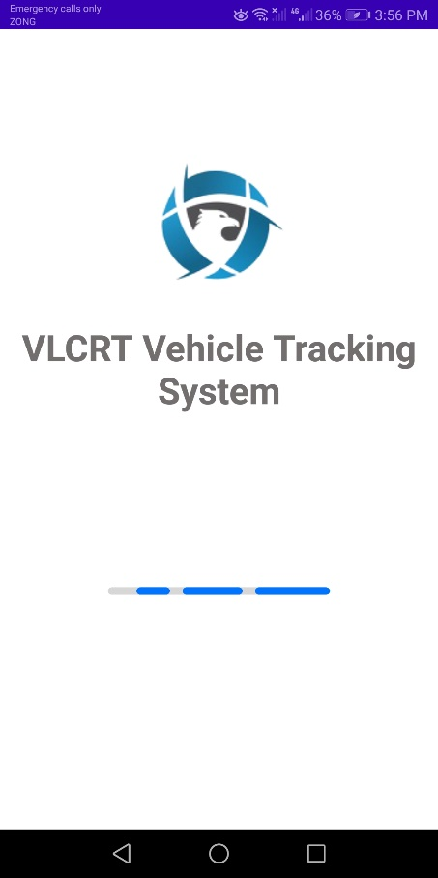
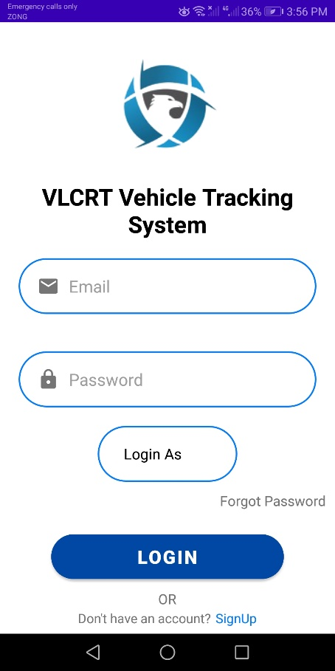
Screen Shots
University Institute of Information Technology, PMAS-Arid Agriculture University- Rawalpindi

Slide 18
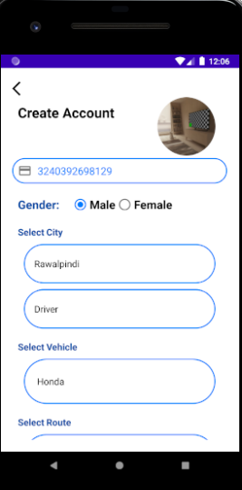
Screen Shots
Add the Screenshots as Per Your Project Status
University Institute of Information Technology, PMAS-Arid Agriculture University- Rawalpindi

Slide 19
Future Project Schedule
Update this List as per Your Supervisor Guidelines
Tasks | Schedule
Design & Coding of Project Manage Vehicles Manage Driver Details Manage Feedback, Session, Gallery Pages & other Pages | 10th February To 30th March 2022
Creating Reports | 1st April to 20th April 2022
Testing of Project Module wise & Finishing the Code | 21st April To 30th April 2022
Integrating Project | 1st May 2022 To 20th May 2022
Testing of Project | 21st May To Finsih Date
University Institute of Information Technology, PMAS-Arid Agriculture University- Rawalpindi

Slide 20


